Slide 1
Transforming a 100,000 person IT Department

Slide 2
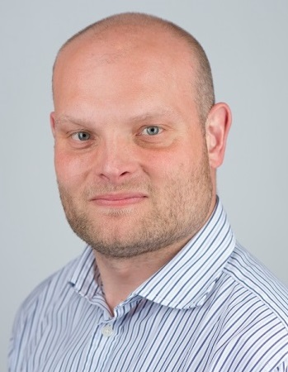

Martin Croker Managing Director, Accenture Technology Architecture
Responsible for DevOps capability at Accenture.

martin.croker@accenture.com
@martincroker

Slide 3
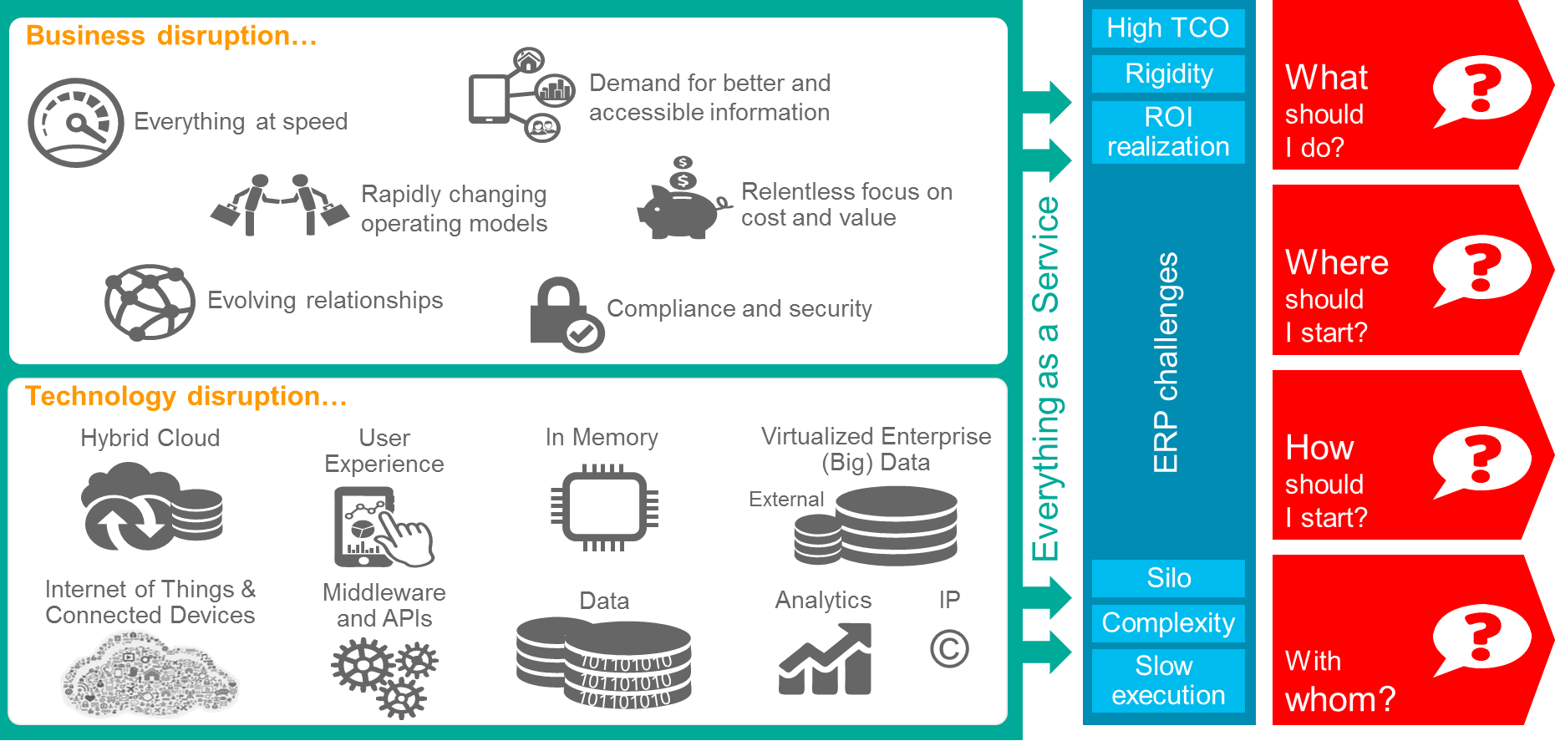
New-IT
Is disrupting every industry
INCLUDING MINE!

Slide 4

Delivery Approaches
More productive architectures
More extensible solutions

Slide 5
Lean IT Culture, Tooling and Ways of Working
DevOps-centric Architecture (what)
Continuous Delivery (how)
Software Defined Platform and Infrastructure
(where)
Cycle-Time
Anti-Fragile Design

Slide 6
Stakeholders
Delivery
Approach
Architecture
Project
Tools
Culture
Skills

Slide 7
Stakeholders
Stakeholders
Stakeholders
Stakeholders
Delivery
Approach
Architecture
Delivery
Approach
Architecture
Delivery
Approach
Architecture
Delivery
Approach
Architecture
Project
Project
Project
Project
Tools
Culture
Tools
Culture
Tools
Culture
Tools
Culture
Skills
Skills
Skills
Skills
Stakeholders
Stakeholders
Stakeholders
Stakeholders
Stakeholders
Delivery
Approach
Architecture
Delivery
Approach
Architecture
Delivery
Approach
Architecture
Delivery
Approach
Architecture
Delivery
Approach
Architecture
Project
Delivery Management
Project
Project
Project
Project
Portfolio Management
Tools
Culture
Tools
Culture
Tools
Culture
Tools
Culture
Tools
Culture
Core Delivery
Skills
Projects
Skills
Skills
Skills
Skills
Delivery Platform
Tools, Methods and Practices
Capability Platform
People - Skills & Culture
Stakeholders
Stakeholders
Stakeholders
Stakeholders
Delivery
Approach
Architecture
Delivery
Approach
Architecture
Delivery
Approach
Architecture
Delivery
Approach
Architecture
Project
Project
Project
Project
Tools
Culture
Tools
Culture
Tools
Culture
Tools
Culture
Skills
Skills
Skills
Skills

Slide 8
Delivery Management
Training
Recruitment
Measurement & Metrics
Projects
Delivery Platform
Capability Platform
People - Skills & Culture

Slide 9
Tools, Methods and Practices
Delivery Management
DevOps Platform
Projects
Delivery Platform
Capability Platform

Slide 10

Engagements
Platform & Delivery Assets
Industry Assets
DevOps Platform
On-Prem
Clouds

Slide 11








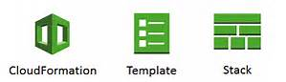

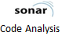


















Cartridge
Platform Extension
ACCENTURE DIGITAL/01
ACCENTURE VIDEO SOLUTIONS
ACCENTURE OPEN WEB PLATFORM
+ Others
Dedicated Instance (OSS)
Managed Service
Core Tools
Roadmap
Selenium
Hybrid
On Premise

Slide 12









Internet
Availability Zone
Availability Zone
Proxy
Proxy
Proxy
Amazon Cloud-formation
Cartridge
Docker Compose
Swarm
Platform Extension
Selenium
Gluster FS
Accenture DevOps Platform Cartridge

Slide 13
Tools, Methods and Practices
Delivery Management
DevOps Platform
Partners
Methods
Projects
Delivery Platform
Capability Platform

Slide 14
Industrialisation Framework
Core Delivery
Delivery Management
Delivery Metrics (Agile vs Waterfall)
myWizard
Projects
Delivery Platform
Capability Platform

Slide 15
Delivery Management
Demand
Offerings
Sales and Solution Process
Delivery
Value
Delivery Platform
Capbility Platform

Slide 16
Blockers
Change volume
Agility requirement
Business criticality
Technology (appl^{n})
Technology (platform)
Delivery maturity
Team skills
Inter-dependencies
Design to Operate
Design to Deliver
Small Batches & Experimentation
Modern Architecture
Greenfield
Vision
Automation
APIs
Pipeline
Test Automation
Existing
Process of CSI
Value
Ease
Enablers

Slide 17
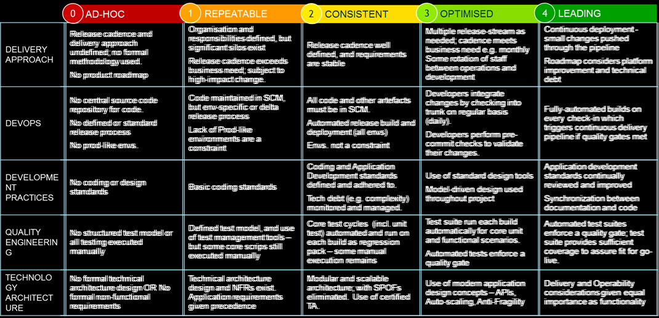
Industrialisation Framework
Portfolio Management
Project Delivery Index
Delivery Management
Projects
Delivery Platform
Capability Platform

Slide 18
What do I want?
To participate as a catalyst for the DevOps exothermic reaction!
…and I’d love for others to use, feedback and contribute to ADOP

Slide 19
Martin Croker Managing Director, Accenture Technology Architecture
Responsible for DevOps capability at Accenture.

martin.croker@accenture.com
@martincroker

